Slide 1
Error Handling

Slide 2
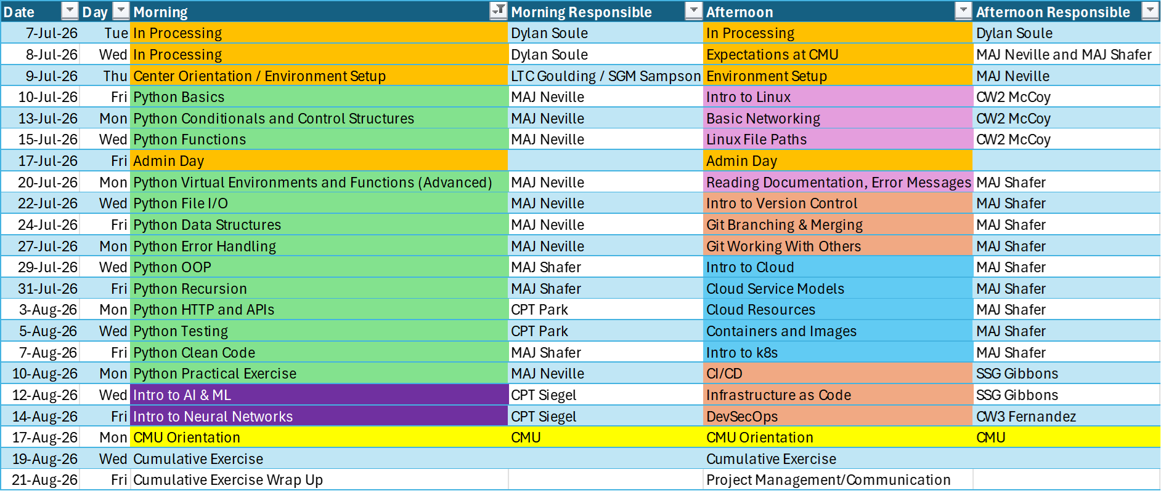
Course Schedule

Slide 3
Review

Slide 4
What did we do last lesson?

Slide 5
Pre Class Problem 1
Write a Python Script that writes 100 random integer values (from 1 to 1000) to another file (.txt) . **Only do this once**
Write another Python Script that opens that file, displays the highest number in the list, the lowest number in the list, and the average of that list.

Slide 6
Pre Class Problem 2
cd into the Lesson 04 folder
Create a virtual environment there. Activate the virtual environment and install all of the dependencies listed in requirements.txt. After you do this, add this folder to your .gitignore within your repo.

Slide 7
PYTHON ERRORS
Errors are issues in a program that prevent it from running as expected
They help programmers find and fix mistakes
Why learn errors?
Errors help you debug
Knowing common errors makes writing and fixing code faster
Good programs handle errors gracefully

Slide 8
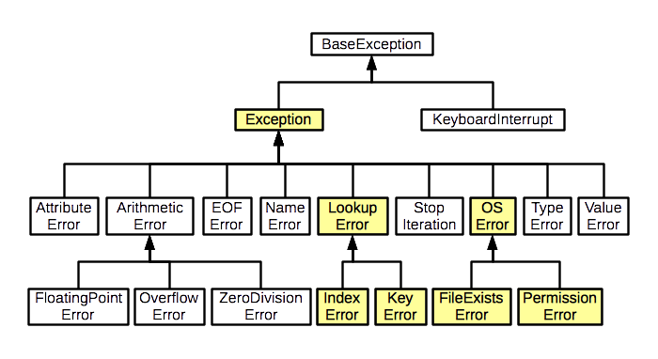
PYTHON ERRORS

Slide 9
EXERCISE - PYTHON ERRORS
5 minutes
Groups of 2-3
Research each python error and demonstrate an example case of when this error will be raised
SyntaxError
IndentationError
TypeError
ValueError
ZeroDivisionError
IndexError
KeyError
AttributeError
FileNotFoundError
ImportError

Slide 10
Type | When it Happens | Example
SyntaxError | Code violates Python’s rules | Missing colon :
IndentationError | Code has wrong indentation | Misaligned blocks
TypeError | Wrong type used in operation | Add int to str
ValueError | Right type, wrong value | int("abc")
ZeroDivisionError | Dividing by zero | 5 / 0
IndexError | Index out of range in a sequence | list[5] with 3 items
KeyError | Missing key in a dictionary | dict["missing"]
AttributeError | Attribute doesn’t exist | int.append()
FileNotFoundError | File does not exist | Open missing file
ImportError | Cannot import a module | Wrong module name

Slide 11
ERROR HANDLING
Why Handle Errors?
Prevent your program from crashing
Provide helpful messages to users
Let your code recover from unexpected situations

Slide 12
TRY - EXCEPT
Tries a block a code and if an error is raised, can handle that error gracefully
try:
# code that might cause an error
number = int("abc")
except ValueError:
print("Oops! That wasn't a number.")

Slide 13
TRY - EXCEPT CONTINUED
Multiple except statements
try:
result = 10 / 2
except ZeroDivisionError:
print("Cannot divide by zero.")
except ValueError:
print(“Incorrect conversion”)
except:
print(“You are seeing this message in error!”)

Slide 14
TRY - EXCEPT CONTINUED
Optional
else: Runs if no error occurs
finally: always runs
try:
result = 10 / 2
except ZeroDivisionError:
print("Cannot divide by zero.")
else:
print("Division successful.")
finally:
print("Done.")

Slide 15
RAISE
“raise” is used to intentionally trigger an error
Helps enforce rules and catch problems early
Make your code more predictable and safe
Useful for custom error messages or defining your own exceptions
if age < 0:
raise ValueError("Age cannot be negative.")
Built-in Exceptions
raise TypeError("This function only accepts strings.")
raise ZeroDivisionError("Cannot divide by zero.")
Raised errors can be caught and handled with try / except
If not caught, they will be passed to the output and stop the program

Slide 16
Exercise (20 min)
Randomly assign a number from 1 to 100.
Write a block of code that takes in user input until they guess the random number
Prompt the user to help them with their guess
Handle the following situations:
User does not input the right python data type
User inputs a negative number
User inputs a number outside the guess range
Hint: use random.randomint() to generate a random number

Slide 17
Exercise 3 (20 min)
Given a list of numbers, write a program that:
Loops through the List: [10, -5, 20, ‘hello’, 5.2, 15, None, 30]
Skips any None values or non-integer types with an error message using try/except
Raises a ValueError if it finds a negative number (stops the program)
Collects all valid positive integers into a new list
Prints the new list and the sum of its numbers
Once you have a solution, remove -5 from the list and run it again.
Hints:
Use isinstance(item, int) to check types
Build the valid list as you go

